Slide 1
Cymbiotika Junior Data Analyst
Will Mino
Junior Data Analyst Candidate

Slide 2

Python Assessment
Cymbiotika’s monthly customer churn rate
2. The number of active subscriptions per customer per/month
3. The percentage of active customers who order each month
4. Starting sub. revenue and Ending sub. Revenue month/month

Slide 3
Calculate the Monthly Customer Churn Rate
This figure is calculated in the file “01_churn_rate.ipynb”

Slide 4
Monthly Churn Rate
Cymbiotika’s Monthly Churn Rate is the percentage of customers who end their subscriptions in a single month.
This figure is calculated with the following formula
Monthly Churn Rate = 100 * [ (lost customers)/(beginning month # of customers) - 1 ]
Monitoring customer churn is essential because it lets us know it may be time to employ resources and measures to prevent customer churn.

Slide 5
Assumptions
The logic of this monthly churn rate calculation is rooted in these assumptions:
I am calculating churn rate based on the number of subscriptions of customers. I used the “assessment_subscriptions.csv” file for the calculation.
Total number of active customers per month will be customers whose subscription was active at one point. So, active includes status=‘ACTIVE’ and ‘CANCELLED’ subscriptions. ‘CANCELLED’ subscriptions must have a ”cancelled_at” date. Any sub active from 5/21 to 7/21 is active during May, June, and July. Ignore ’EXPIRED’ and subs ‘transferred’ from old database.
A churned customer had >1 subscription in any month, but then zero subscriptions in the next month.
Ongoing ’ACTIVE’ subscriptions have no cancelled_at date. So, these subscriptions are active for 2023 and beyond.

Slide 6
Methods
Import “assessment_subscriptions.csv” as a table.¹
Per active subscription, a column field will hold all months the sub was active. Add rows to the datable to represent each subscription_id with each corresponding month in which it was active.
Customers are lost when subscriptions are cancelled, so filter table for rows where status column = ‘CANCELLED’.
4. Sort the filtered table by ”customer_id” and “active_months” columns ascending.
5. Create a column called ”active subscriptions”. In the column, set active sub = 1, no subscriptions per customer in a month = 0.
6. Since columns are grouped by each customer, the months of their active subscriptions appear sequentially. When a customer loses all subs, the values in the column will always go from 1 to 0.

Slide 7
Methods Continued…
7. Apply a function that counts every row of the table and returns a list of True or False values. Every time an event occurs where a row has a 1 and the next row has a 0, count this specific event as a lost customer event.
8. True/False values list is tracked to each customer_id. We apply this new list to the original table (using groupby function, like a pivot table) since each list had the same marker on it (index position number). Once we group all the data by the .count() of the True values by month, we will see lost customers per month.
9. Calculate the churn rate by taking the lost customers per month divided by the total number of customers per month. Subtract -1. And finally multiple by 100 to get a %.
Monthly Churn Rate = 100 * [ (lost customers)/(beginning month # of customers) - 1 ]

Slide 8
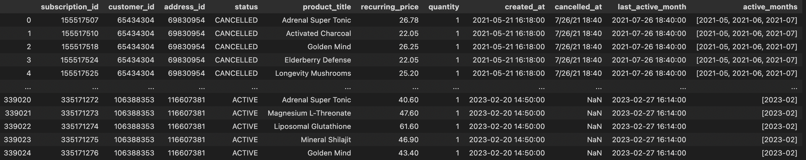
Analysis
Created last_active_month column for range calculation.
Created active_months column w/ list of each subs active month
Created active_months column w/ list of each subs active month

Slide 9
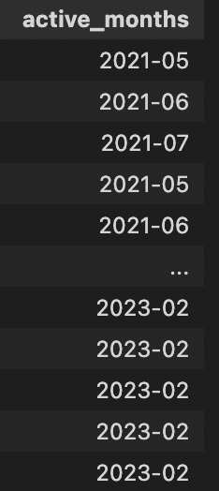
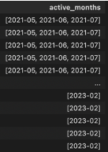
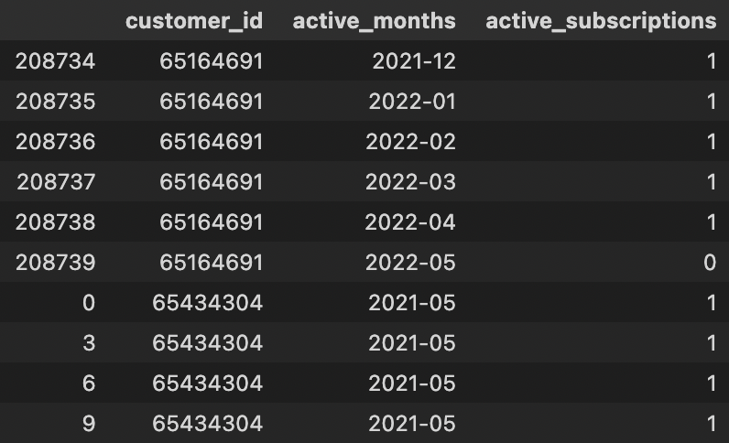
Analysis
Coding function turned the list of dates into rows in the table
Active_subscriptions columns created to give active sub =1; customer w/ no sub = 0
Function gives a “marker” (True) value for each time a 1 to 0 happens between 2 rows
Lost customer
”churn_table”

Slide 10
Analysis
We can then combine our list of lost customer events with our ”churn_table”. Grouping by each month will give us a count of lost customer events per month.
Churn rate denominator in calculation is the total customers per month, which we get by taking off the ‘CANCELLED’ filter. Now all ‘ACTIVE’ status customers and ‘CANCELLED’ status customers, who had active subscriptions at one point in time, will have data points (table rows) for each month in which their subscription. We can then get total number of customers per month.
This total number of customers is obtained by grouping all the data by “month” and getting the number of unique customers per month.

Slide 11
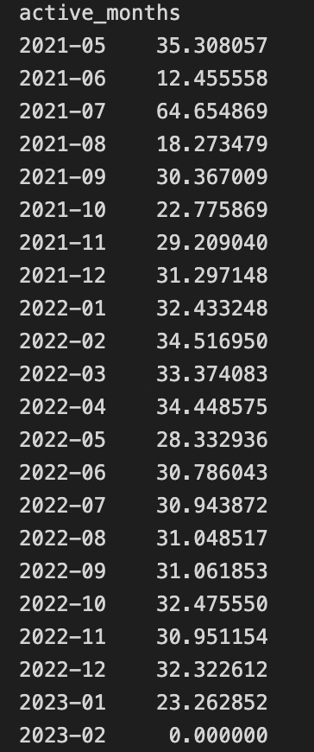
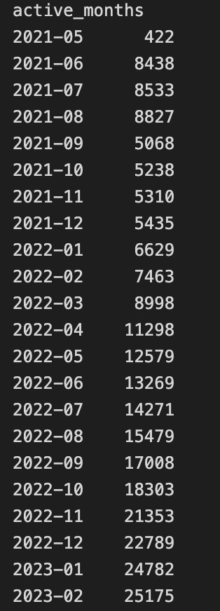
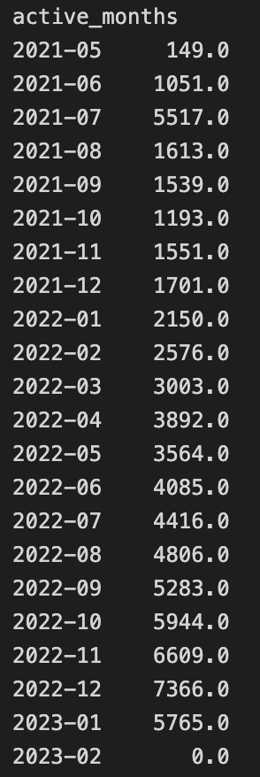
Analysis
Using our churn rate formula
100*
- 1

Slide 12
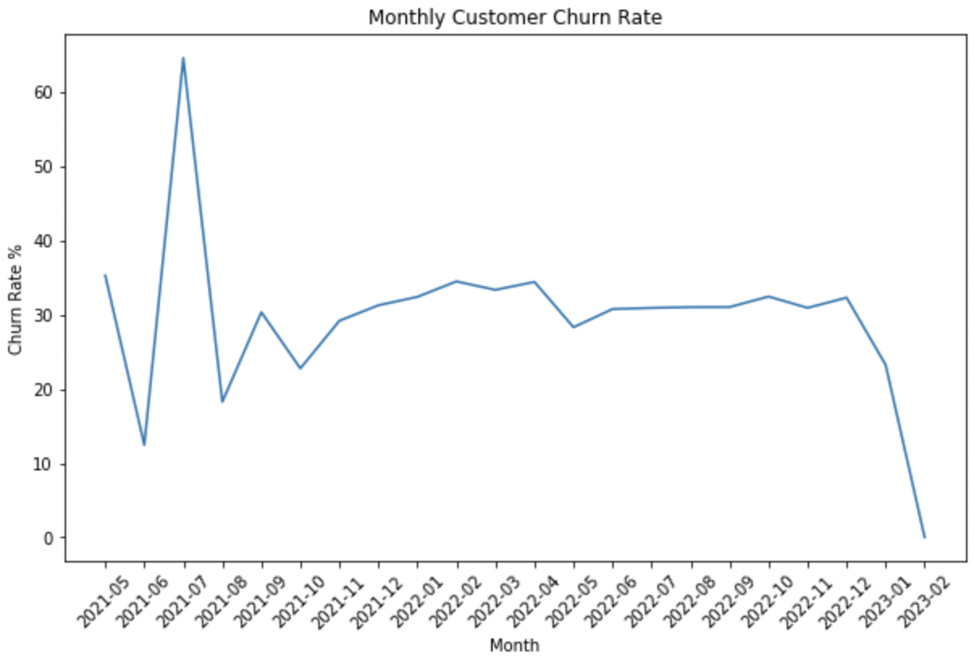
Results
active_months | Churn Rate %
2021-05 | 35
2021-06 | 12
2021-07 | 65
2021-08 | 18
2021-09 | 30
2021-10 | 23
2021-11 | 29
2021-12 | 31
2022-01 | 32
2022-02 | 35
2022-03 | 33
2022-04 | 34
2022-05 | 28
2022-06 | 31
2022-07 | 31
2022-08 | 31
2022-09 | 31
2022-10 | 32
2022-11 | 31
2022-12 | 32
2023-01 | 23
2023-02 | 0

Slide 13
Conclusion
Cymbiotika has consistently exhibited a 20 to 35% monthly customer churn rate over the last two years.
Cymbiotika had a spike in customer churn in July, 2021. 0% churn for small sample size, likely due to early date in Feb., 2023; no cancellations as of date.
The company hopes to decrease its customer churn rate with its new loyalty retention program.

Slide 14
The Number of Active Subscriptions per Customer per Month
This figure is calculated in the first half of the file
“02_03_active_subs_active_orders.ipynb”

Slide 15
Assumptions
The logic of the “active subscriptions per customers per month” calculation is rooted in these assumptions:
A subscription cancelled in any given month is still considered active in this calculation because the subscription was active for part of that month.
Filtering for rows where status = ‘ACTIVE’
Ongoing ’ACTIVE’ subscriptions have no cancelled_at date. So, these subscriptions are active for 2023 and beyond.

Slide 16
Methods
Obtain a table that has all the rows corresponding to each customer-subscription_month pair.
Filter the table for rows where status value is ‘ACTIVE’.
Finally, group the filtered table by the “active_months” and “customer_id” columns. Make the values in each row the sum of the quantity of subscriptions per customer per month.

Slide 17
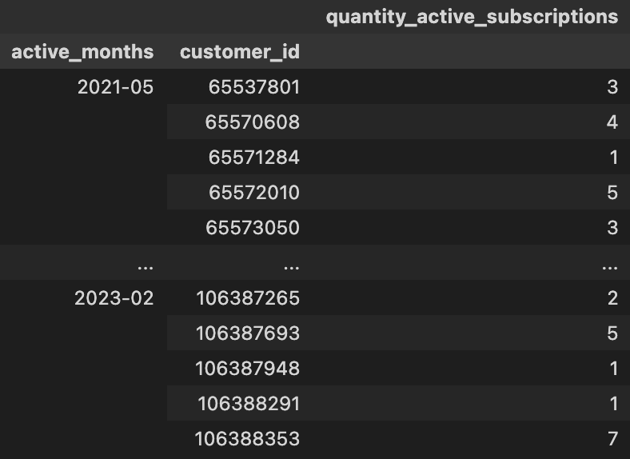
Analysis
We obtained a table listing each customer per month and their corresponding quantity of active subscriptions.
There are so many customer and month pairs in the table that it may be necessary to view a sum aggregation of active subscriptions per month instead

Slide 18
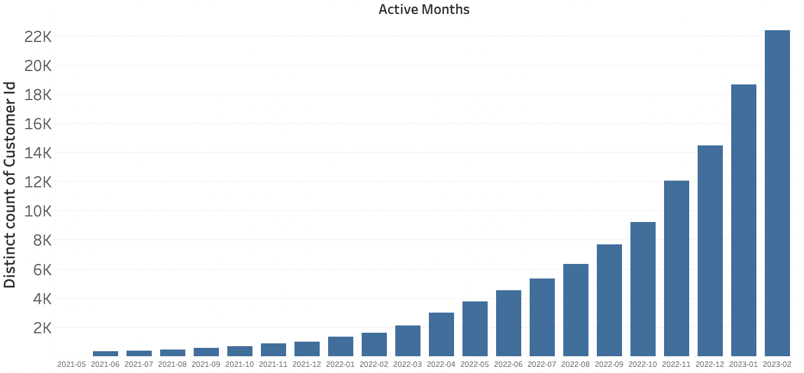
Active Subscriptions per Month

Slide 19
Conclusion
Cymbiotika has had an increasing number of active subscriptions per month since May 2021.
The final table for Active Subscriptions per Customer per Month was exported into the parental folder by code in the file “active_subs_per_customer_per_month.csv”

Slide 20
PERCENTAGE OF ACTIVE CUSTOMERS WHO ORDER EACH MONTH
This figure is calculated in the second half of the file
“02_03_active_subs_active_orders.ipynb”

Slide 21
Assumptions
The logic of the “active subscriptions per customers per month” calculation is rooted in these assumptions:
The total number of active customers per month comes from customers who are currently active meaning status= ‘ACTIVE’ as of 2/2023.
Orders = charges_df table rows where type = ‘CHECKOUT’ and status = ‘SUCCESS’. These are one time orders. The resulting data only includes orders from 9/2022 to 12/2022.
Ongoing ’ACTIVE’ subscriptions have no cancelled_at date. So, these subscriptions are active for 2023 and beyond.
Ignore ’EXPIRED’ and subs ‘transferred’ from old database.

Slide 22
Methods
Filter subscription_df table for rows where status = ‘ACTIVE’.
Filter charges_df table for rows that are one time orders (not recurring payments)
Create a new ID “customer_order” in each table. For the active subscriptions table, concatenate the text of each value of the “active month” column and the “customer_id “column. For the charges_df, concatenate the text of the value of the “created_at” and the“customer_id” column. This new unique ID allows us to track an active customer who may have also submitted one-time orders.
Isolate the unique “customer_order” IDs from the charges_df table.
Merge the filtered and grouped active subscriptions table with the list of unique customer_order IDs from the filtered charges_df table. They can be merged because they have the same “customer_order” IDs.

Slide 23
Methods Continued…
6. Group the merged table by month to get the unique number of customers who are active and order each month.
7. Group the ”active_subscriptions” table by month and get the total unique number of customers.
8. Calculate the percentage of active customers who order each month by taking the table generated in step 6, and dividing it by the data table generated in step 7. Multiply by 100 to convert to a percentage.

Slide 24
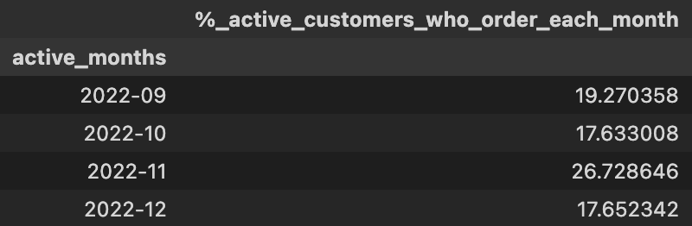
Analysis
The final table generated was the “percent_of_active_customers_who_order_each_month”
There are only four months worth of data because I selected for one-time orders that had a successful transaction (no refunds/ no partial refunds/ no cancellations).

Slide 25
Conclusion
Cymbiotika customers with active subscriptions also submitted one-time orders during the months of September to December 2022.
At least 17% of these customers submitted orders during these months. In November 2022, 26% of active customers also submitted orders.

Slide 26
STARTING AND ENDING SUBSCRIPTION REVENUE MoM
This figure is calculated in the second file “04.ipynb”

Slide 27
Assumptions
The logic of the “starting and ending subscription revenue month/month” calculation is rooted in these assumptions:
I will be looking at the months in which a subscription was active and paid for by a recurring price. Unlike the previous examples, I won’t be counting the month in which the subscription was cancelled as an active subscription-month. Thus, I will take off one index position relative to the previous list of months that was created per row, unless the length of the list is 1.
This calculation is only for subscriptions. I am not including the charges_df “CHECKOUT” transactions.
Ignore ’EXPIRED’ and subs ‘transferred’ from old database.

Slide 28
Methods
Obtain a table that has all the rows corresponding to each customer-subscription_month pair in which a subscription period was paid for.
Filter the “subscriptions_df” table to include all subscription months that have have a valid “last_active_month” value. Correlates to all rows w/ non null “cancelled_at” date
Create column “subscription revenue per month” which multiplies each customer’s subscription month’s recurring_price by the quantity of the row.
Group the processed table by month and set the row values as the sum of the subscription revenue per month. This will give each month’s total subscription revenue.
Since the grouped table does not contain cancelled subscriptions in it, the next month’s subscription revenue will be the previous month’s ending subscription revenue.

Slide 29
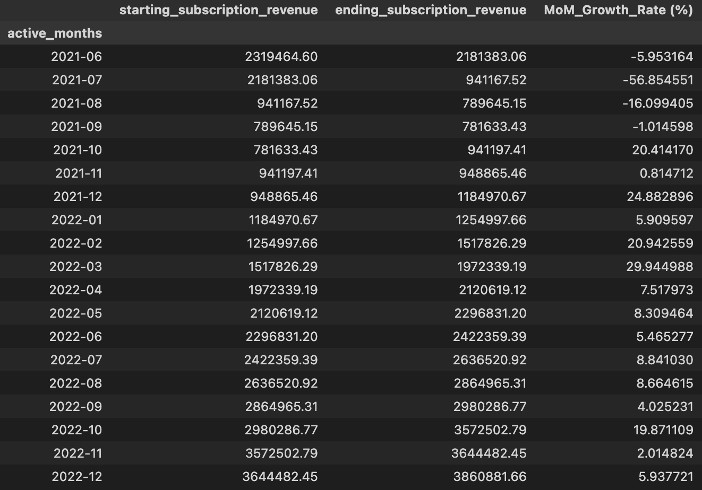
Analysis
We obtained a table that has the starting subscription revenue and the ending subscription revenue for each month. The next month’s subscription revenue served as the previous months ending subscription revenue.
A Month over Month growth rate was also calculated by taking the percentage change between a month’s starting subscription revenue and a month’s ending subscription revenue.

Slide 30
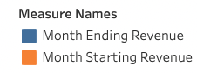
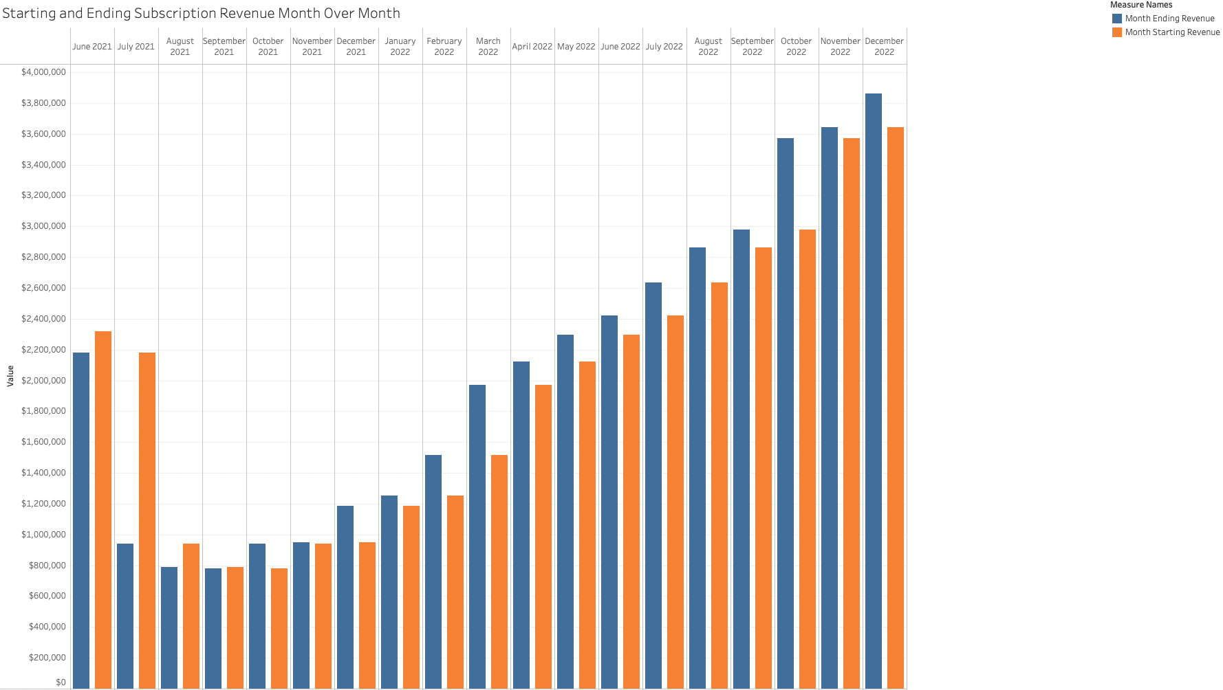
Active Subscriptions per Month

Slide 31
Conclusion
From October 2021 to Present: Cymbiotika has exhibited consistent revenue growth month over month.
The Month over Month Revenue Growth Rate during this period ranged from a low of just under 1% in November, 2021 to a high of 30% revenue growth in March, 2022.
A 57% decrease in revenue occurred in July 2021.
The final table for was exported into the parental folder by code in the fileas “start_and_end_sub_revenue.csv”

Slide 32
Footnotes
1. Importing csv files into Python is possible using the Pandas module in Jupyter Notebook. The line of code: all_subs = pd.read_csv("assessment_subscriptions.csv”), allows for this. Also, the line of code subscriptions_df = pd.DataFrame(all_subs) agrants us the ability to create a DataFrame. This is the Pandas equivalent of tabular data.

Slide 33




Thank you
Will Mino
will.mino@yahoo.com
https://github.com/willmino/

